Slide 1

Customer Retention Analysis
Submitted by:
Nazia

Slide 2
Table of content
Introduction
Analysis
Conclusion

Slide 3
Introduction
E-retail factors for customer activation and retention: A case study from Indian e-commerce customers :
Customer satisfaction has emerged as one of the most important factors that guarantee the success of online store; it has been posited as a key stimulant of purchase, repurchase intentions and customer loyalty.
A comprehensive review of the literature, theories and models have been carried out to propose the models for customer activation and customer retention.
Five major factors that contributed to the success of an e-commerce store have been identified as:
Service quality,
System quality,
Information quality,
Trust and net benefit.
The research furthermore investigated the factors that influence the online customers repeat purchase intention.
The combination of both utilitarian value and hedonistic values are needed to affect the repeat purchase intention (loyalty) positively.
The data is collected from the Indian online shoppers. Results indicate the e-retail success factors, which are very much critical for customer satisfaction.

Slide 4
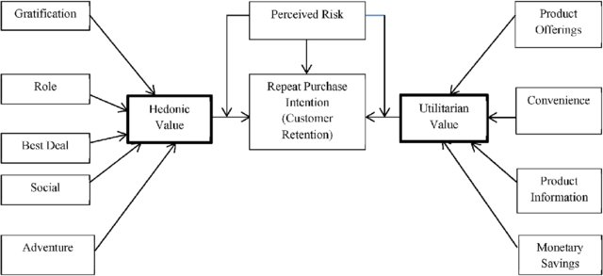
Key Method Utilitarian value is proposed as a formative second-order construct formed by product offerings, product information, monetary savings and convenience.
Hedonic value is also proposed as a formative second-order construct formed by the six hedonic benefits that have been identified in prior research

Slide 5
Customer Retention
Customer retention refers to the ability of a company or product to retain its customers over some specified period.
High customer retention means customers of the product or business tend to return to, continue to buy or in some other way not defect to another product or business, or to non-use entirely.
Selling organizations generally attempt to reduce customer defections.
Customer retention starts with the first contact an organization has with a customer and continues throughout the entire lifetime of a relationship and successful retention efforts take this entire lifecycle into account.
A company's ability to attract and retain new customers is related not only to its product or services, but also to the way it services its existing customers, the value the customers actually perceive as a result of utilizing the solutions, and the reputation it creates within and across the marketplace.

Slide 6
Why focus on Customer retention
Inconvenience
Service encounter failure
Response to failed service
Pricing, competition, ethical concern
Involuntary switching

Slide 7
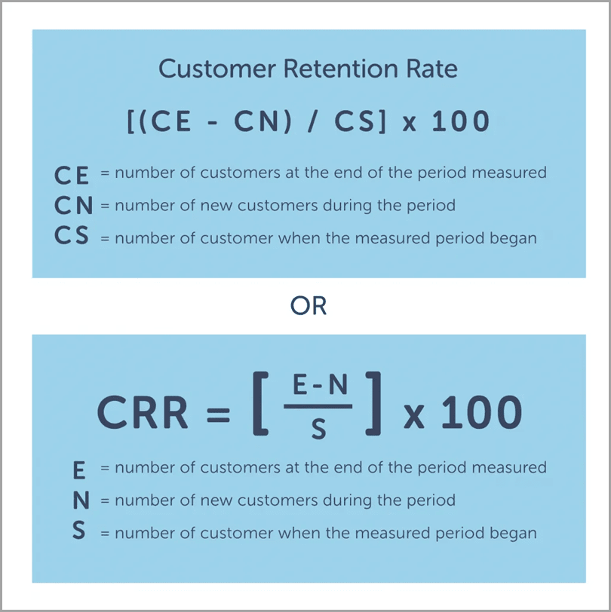
How to calculate CRR

Slide 8
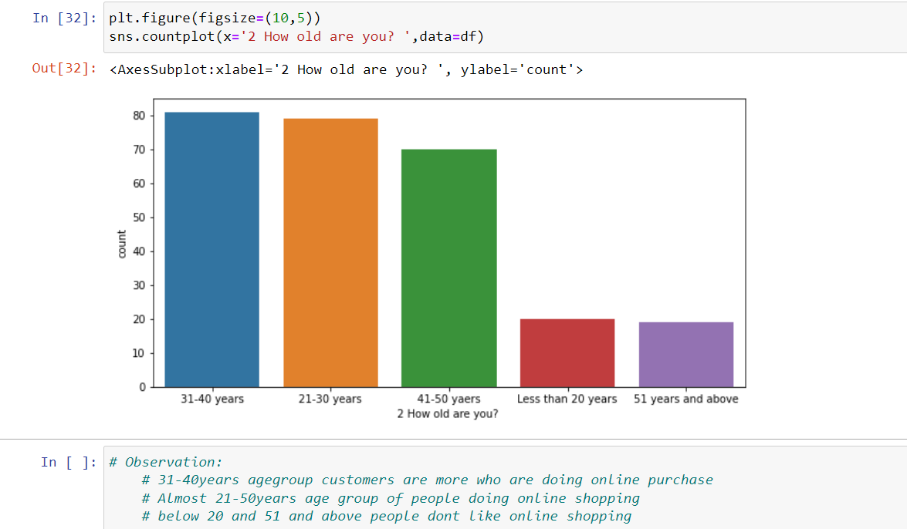
Data Analysis
Age of the customers: Customers by the age group of 31-40 years and 21-30 years have highly active online transactions compared to other lower and higher age groups

Slide 9
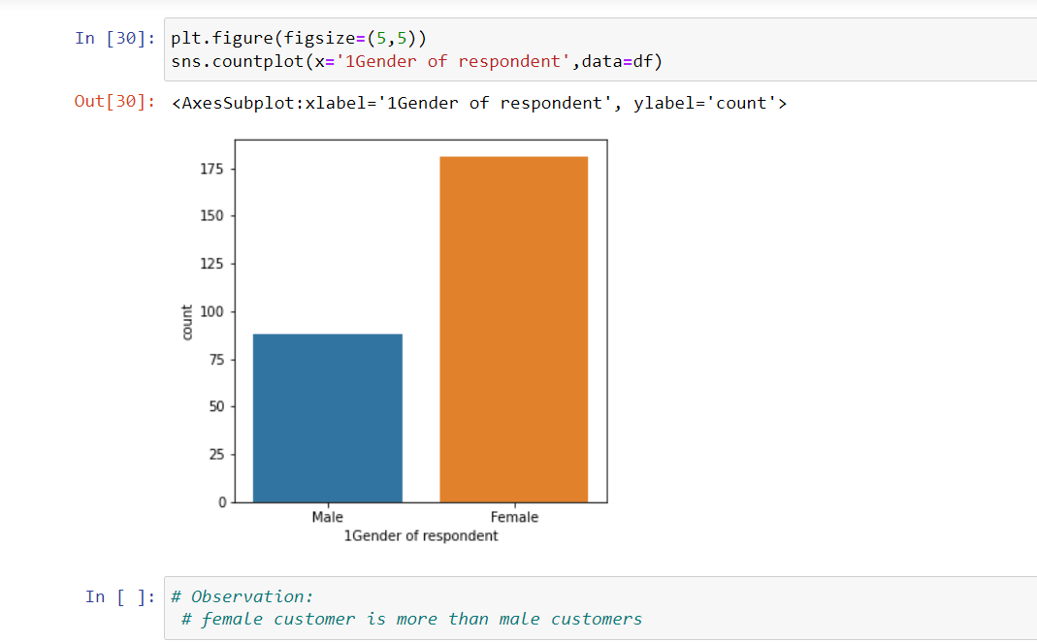
Gender of the customers: Female Customers are more than male customers

Slide 10
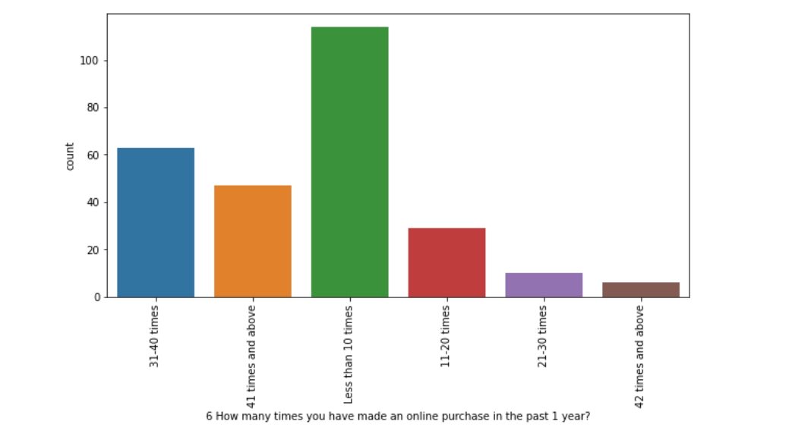
Number of times shopping is made in past one year: Highest number of people shopped online less than 10 times in the past one year

Slide 11
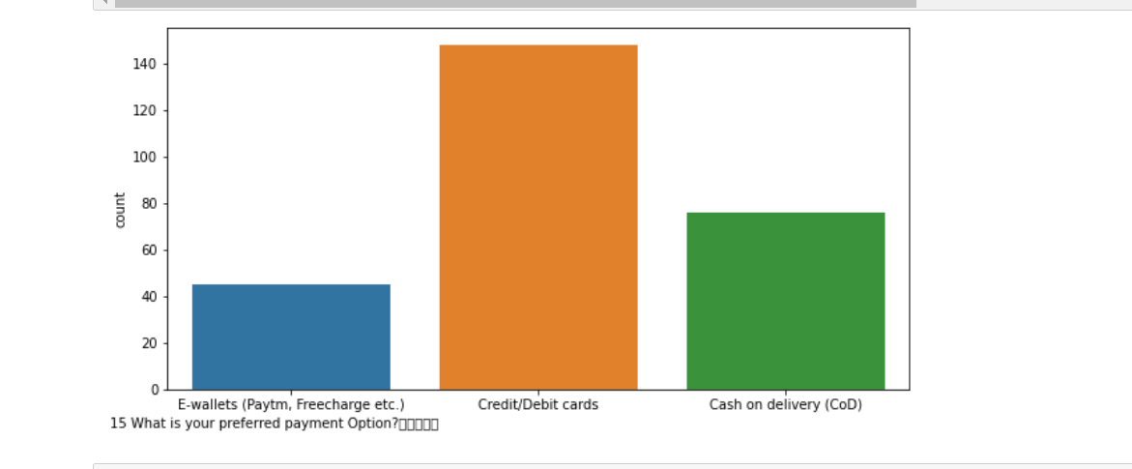
• Customers preferred payment option: Most customers prefer Credit/Debit cards as a payment option, while some of the customers prefer Cash on delivery.

Slide 12
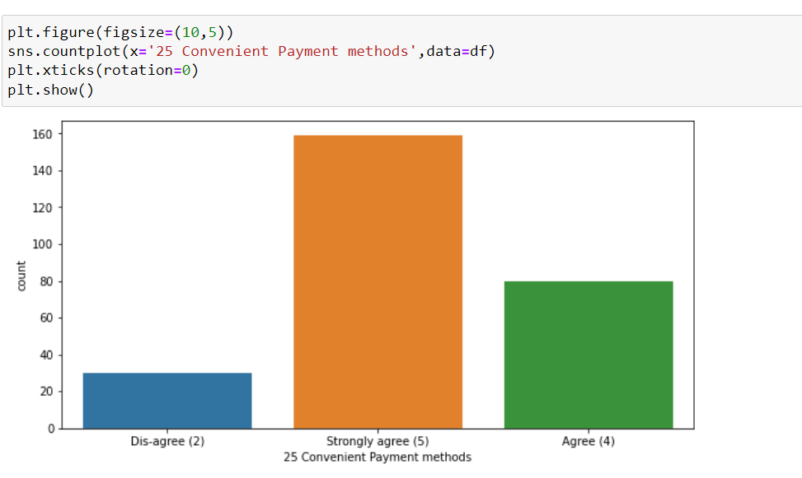
Customers preferred convenient payment method: Most customers prefer convenient payment method for payment option

Slide 13
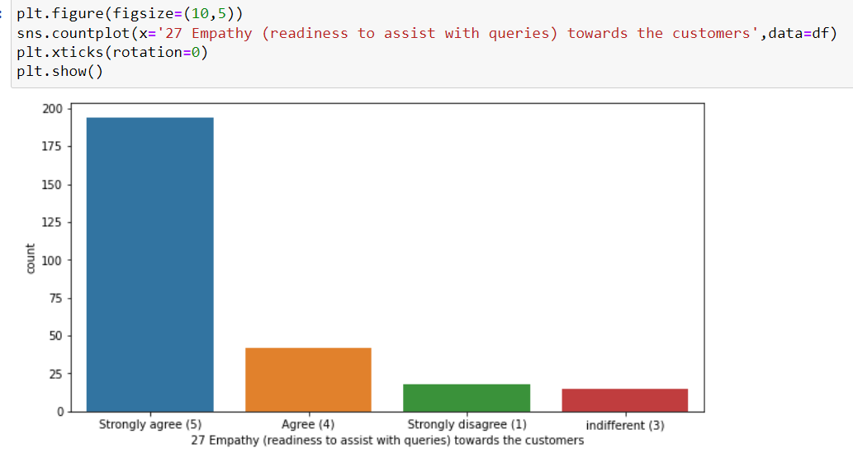
Empathy towards customers: Most customers strongly believe that Empathy towards customers is necessary for online shopping

Slide 14
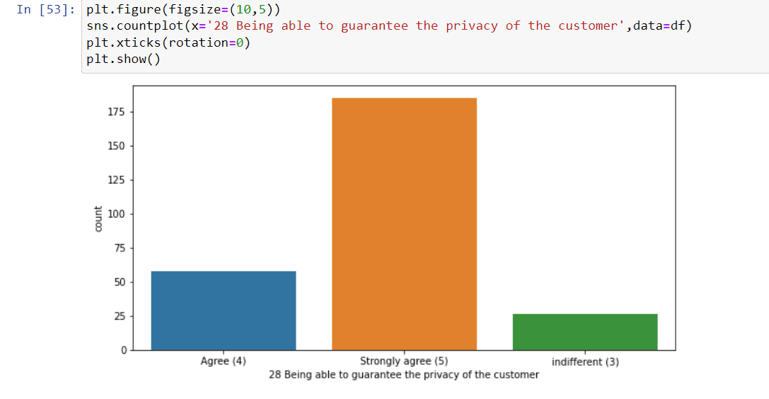
• Privacy of customers: Most customers strongly believe that privacy of customers are necessary for online shopping

Slide 15
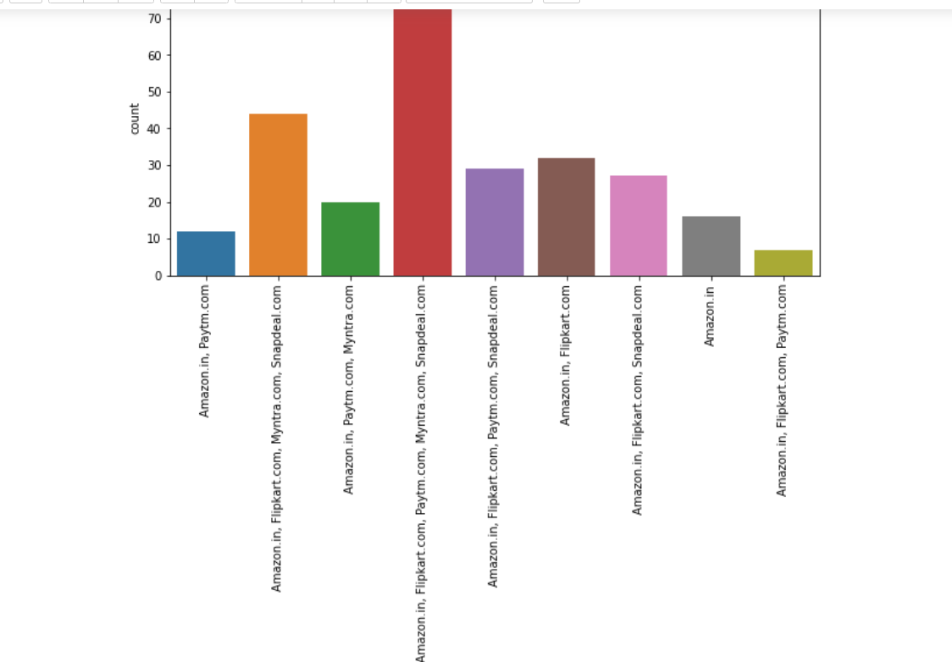
Online Retailer: Most customers believe in Amazon.in, flipkart.com, Paytm.com, snapdeal.com

Slide 16
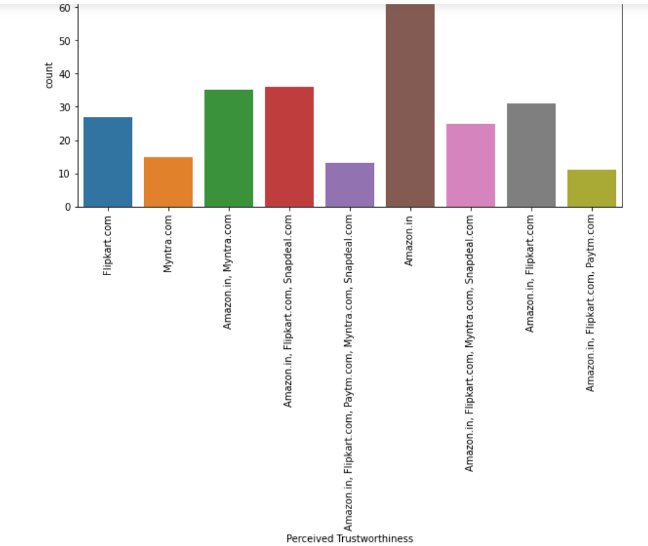
• Perceived trustworthiness : Most trusted shopping site,customers believe in Amazon.in

Slide 17
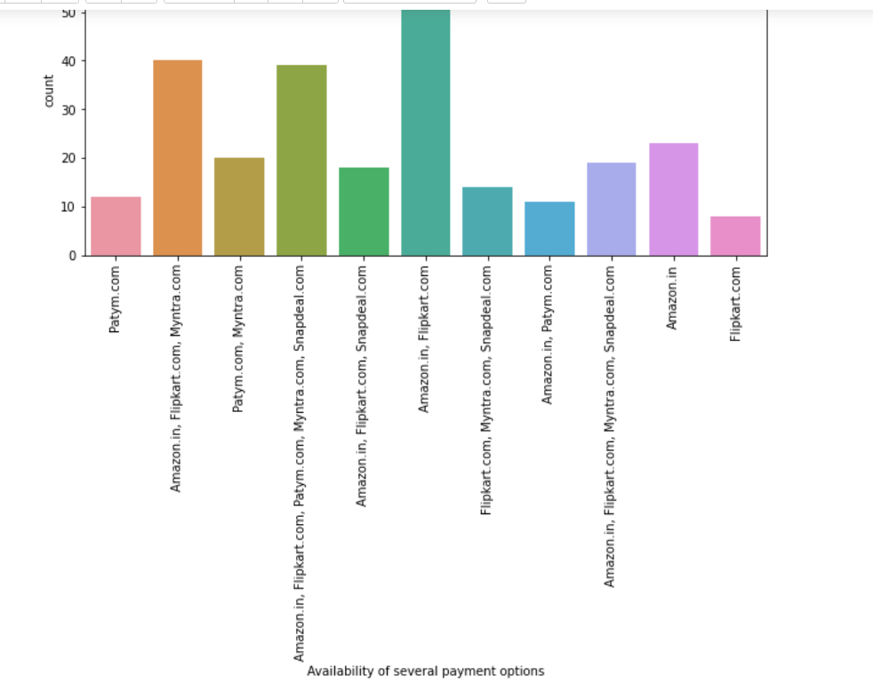
Best in several payment options: Most customers believe in Amazon.in, flipkart.com for that

Slide 18

Skewness

Slide 19

Outliers

Slide 20
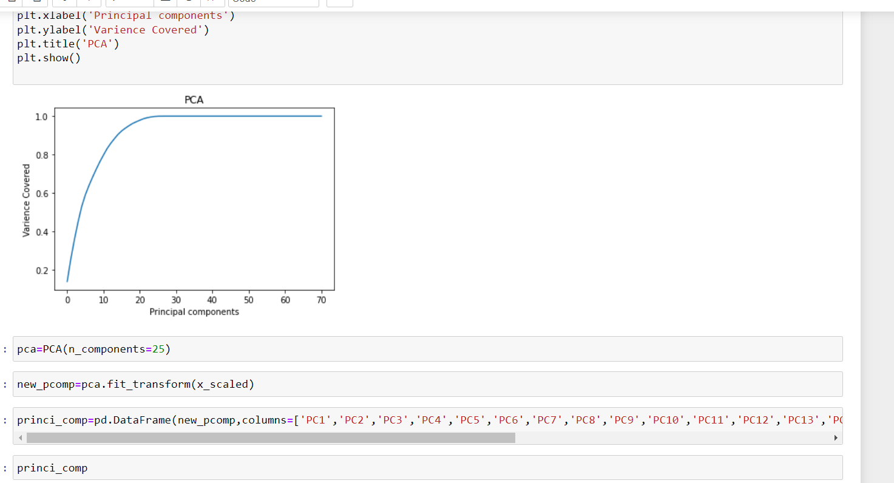
PCA(Principal Components Analysis

Slide 21
Retention
Product
Engagement
Customer Support
Customer
Success
Marketing
Retention strategy

Slide 22
Conclusion
Customer satisfaction is important to win the customer back. There is lot of competition in e-commerce space of retailers hence company should focus in offering the best service.
Convenience
The interface should be user friendly. There should be complete description of the product on the website or application and it should be efficient to use.
Security
Company should win customer trust that their personal and financial details are secure with us and will not be used for any fraudulent activity.
Satisfaction
Post purchase evaluation that results from a comparison between pre-purchase expectation and actual performance
Loyalty
One of the best way to retain the customer is to have a rewarding loyalty program. Customer should feel invested in the company and they will be happy that every purchase they are making will lead to more rewarding experience.
Technical
Any issue while browsing should be addressed. Customer may lose out on the deal if there is some glitches or technical issue with the website. The browsing should be quick especially during the sale or promotion period.

Slide 23
Thank You

